Slide 1
TERNA ENGINEERING COLLEGE
Computer Engineering Department
TWITTER DATA ANALYSIS
GROUP MEMBERS:
UMAIR AKHTAR
NADEEM YOOSUF
SHYAM NAIR
PROJECT GUIDE:
Mr. D.K. CHITRE

Slide 2
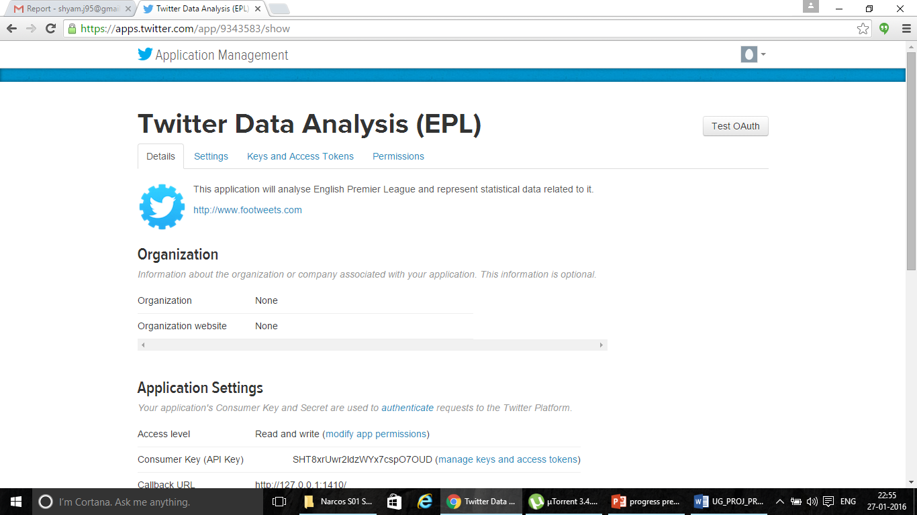
Creating a TWITTER APPLICATION

Slide 3
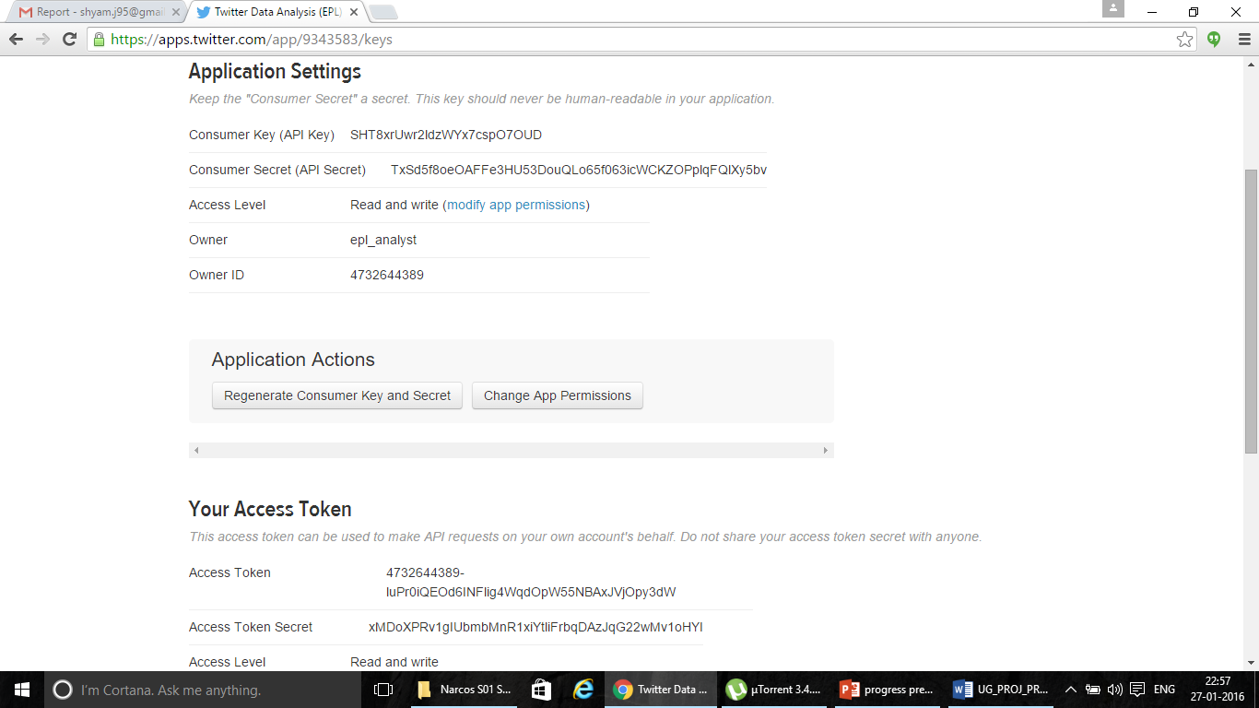
GENERATING TOKENS

Slide 4
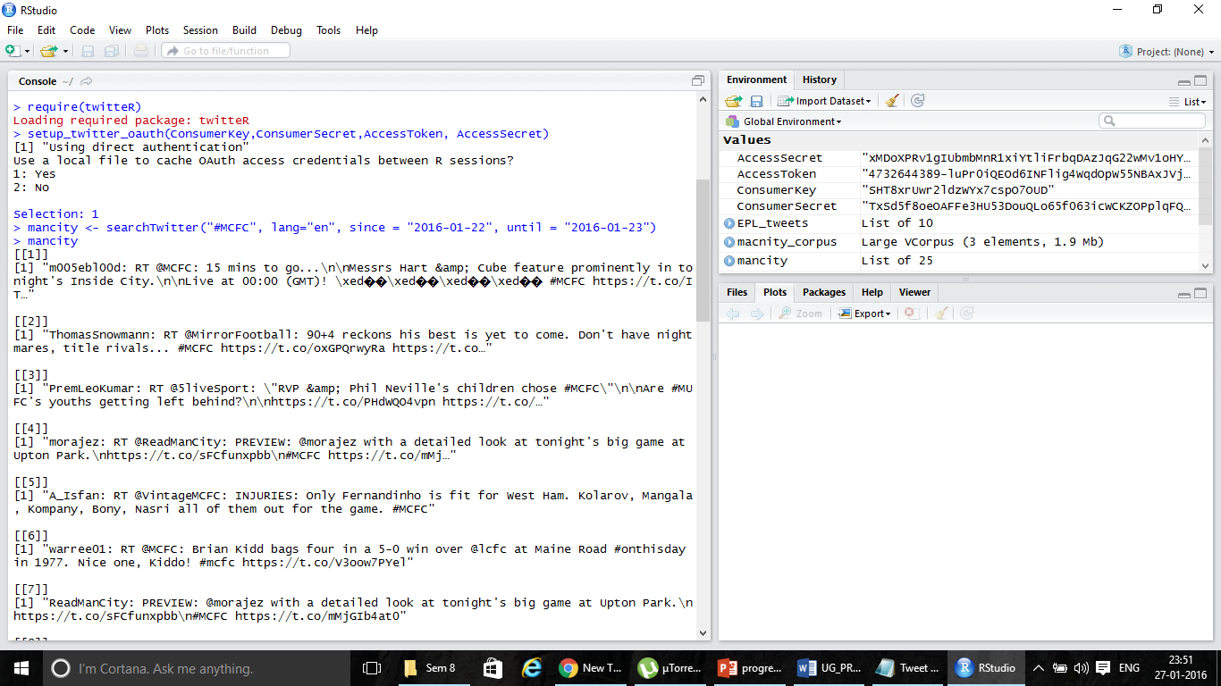
EXTRACTING TWEETS

Slide 5
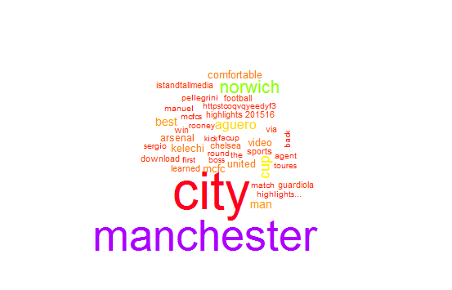
GENERATING WORDCLOUDS
require(wordcloud)
Loading required package: wordcloud
Loading required package: RColorBrewer
wordcloud(mancity_text, colors=rainbow(50),max.words = 40, order="FALSE")

Slide 6
Creation of project

Slide 7
THANK YOU

